Slide 1



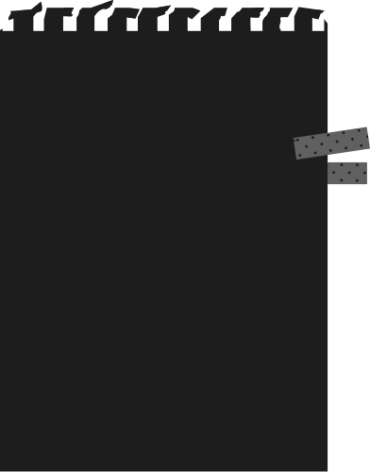


LoRA
research paper explained

Slide 2




SECTIONS
Here are the sections we are going to see about
Abstract
Introduction
Problem Statement
Problems in Existing Solution
LoRA Method
Understanding the Low Rank Updates

Slide 3
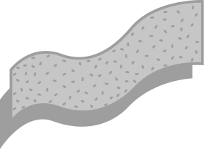
ABSTRACT
No additional inference latency unlike conventional adapters, higher training throughput, and performance on par or better than a fully finetuned model are some of the key features of LoRA
LoRA technique proposed in this paper freezes pre-trained weights and injects a trainable rank decomposition matrix to train in reduced params for downstream tasks
With increased larger pretraining of models full finetuning requires all params to be tuned as well which becomes less feasible. For eg: GPT3(175 B)

Slide 4
INTRODUCTION
Challenges Existing: Full finetuning tunes all the parameters of a large pre-trained model making it inconvenient to train such pre-trained models
Existing Solutions - Adapters: With only a few parameters needed for new tasks it is only needed to store and load a small number of task-specific parameters for each task in addition to the pre-trained model
Problems in Existing Solution: Adapters failed to match the performance of a fully finetuned model

Slide 5


INTRODUCTION - KEY INSPIRATION
"Over-parameterized models, in fact, reside in a low intrinsic dimension" is a key inspiration for this paper which means that large models can learn with low dimensional inputs

Slide 6
INTRODUCTION - HYPOTHESIS
"Change in weights during model adaptation also has a low intrinsic rank" which states that model weight can adapt with very less linearly independent vectors
Note:
dimension - all rows
rank - linearly independent rows
So for eg: 1000 dimension can be expressed in terms of 10 linearly independent rows(rank)

Slide 7

INTRODUCTION
LoRA allows training some dense layers indirectly by optimizing rank decomposition matrices of dense layer

Slide 8
INTRODUCTION
Advantages of LoRA
01
02
Efficiently train multiple tasks by switching decomposition matrices
Lowers the hardware barrier by 3 times since gradient is calculated only for injected matrices
03
04
Simple linear design allows merging trainable weights with frozen weights which results in no additional inference latency
LoRA can be combined with some other previous adapter methods like previous tuning

Slide 9
PROBLEM STATEMENT
Given a pre-trained language model, PΦ(y|x) parameterized by Φ while finetuning for different tasks in context target pairs Z = {(xi, yi)}i=1,.., N where xi and yi are a sequence of tokens based on the use case.
During full finetuning pre-trained weights are updated as follows:
Φ0 + ∆Φ
Here the main drawback is that dimension of finetuning is the same as pretraining
|∆Φ| = |Φ0|

Slide 10
PROBLEM STATEMENT - SOLN.
Considering a parameter-efficient approach where
∆Φ = ∆Φ(Θ)
In the above equation, Θ represents the smaller set of params with,
|Θ| << |Φ0|
With this smaller set of params, optimization is easy since the trainable params(|Θ|) can be as small as 0.01 % of |Φ0|

Slide 11
PROBLEMS IN EXISTING SOLN
Adapter Layers Inference Latency:
Though there are different types of adapters like two or one per block experimented it wasn't possible to bypass the extra compute. Large NN expects parallelism but adapters expect sequential. In a sequential computing scenario in GPT, the latency was been able to notice
2. Directly Optimizing the Prompt is Hard:
Some of the previous adapter techniques focusing on compute aspects such as prefix tuning where it reserves part of sequence length for adaptation to reduce compute by seq length for downstream tasks. But here the performance wasn't as expected

Slide 12
LoRA Method

Slide 13
COMPARISON FULL VS LORA
Full Fine-tuning
LoRA Fine-tuning
Pretrained Weights
𝑊 ∈ ℝ𝑑×k
Weight
Update ∆W
Pretrained Weights
𝑊 ∈ ℝ𝑑×k
𝐵 = 0
B ∈ ℝr×k
r
𝐴 = 𝒩(0, 𝜎2)
A ∈ ℝ𝑑×r
d
d
x
x
Wnew = Wold + ∆W
Wnew = Wold + WA.WB
If ∆W = d x k is 100 x 500 then params in total = 100 x 500 = 50000
Here with r = 4, ∆W in params in total = 100 x 4 + 4 x 500 = 2400

Slide 14
LoRA METHOD - UPDATION METRICS
As per the hypothesis, we can represent the weight matrix as follows
𝑊0 ∈ ℝ𝑑×k
The weight updation can be done as follows,
Wnew = Wold + ∆W
Here from the architecture diagram of LoRA, we can see that ∆W = WA.WB where,
A ∈ ℝ𝑑×r, B ∈ ℝr×k, r -> intrinsic rank
During finetuning W0 is frozen so no gradient updation on the params of the pre-trained model. Only the decomposition matrices A and B contain trainable parameters that update.

Slide 15
LoRA METHOD - UPDATION METRICS
A forward pass for h = W0x can be written as follows
h0 = W0x + BAx
Initially, ∆W = 0, where there is weight initialization for A and B as follows
A -> Gaussian Initialization(𝐴 = 𝒩(0, 𝜎 2 )), B -> Zero(𝐵 = 0)
Then we scale the weight updation ∆Wx = BAx by
α/r, where α -> lora alpha is a constant in r
While optimizing with Adam it is almost similar to the learning rate(LR). Unlike previous adapter models which converge to an MLP and can't take long sequences here, LoRA converges to the original training model.

Slide 16

LoRA METHOD ON TRANSFORMER
Initially, the study is limited to adapting only attention weights for the downstream tasks freezing MLP modules for parameter efficiency and simplicity
Wq(Wk, Wv) is treated as a single matrix
Usually Wq and Wv are considered as target modules for adaptation

Slide 17

PRACTICAL BENEFITS OF LORA
Memory Reduction and Storage Usage: This is the most significant usage of LoRA where it reduced the memory consumption drastically. For eg: With r=4, target_modules = ["query_value"] the checkpoint of GPT3 was 35 MB which is 10000x lesser than the original one. The conversion came in the following way:
1.2TB -> 350GB since we don't store the optimizer state for frozen params
With the above specified hyperparams, the model was reduced from 350GB -> 35 MB. Hence the adapter module size was only 35 MB
Task Switching: Another key benefit in practice of LoRA is that it is possible to swap the lora modules for specific downstream task

Slide 18
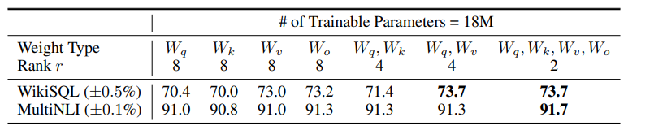
UNDERSTANDING THE LOW-RANK UPDATES
(i) Which matrices should we apply to?
Referring the table it is very clear that we can achieve very competitive performances by just focusing on Wq, Wv => Matrices to be applied are Wq, Wv

Slide 19
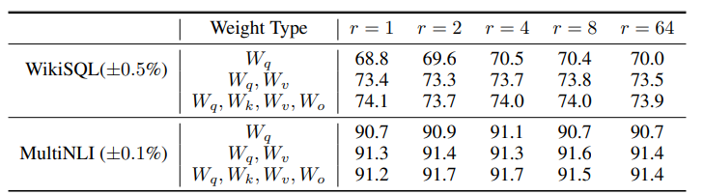
UNDERSTANDING THE LOW-RANK UPDATES
(ii) What is the optimal rank for lora?
From the table of comparison, we can conclude that we can use 4 or 8.
=> r = 4 or 8 based in params budget

Slide 20
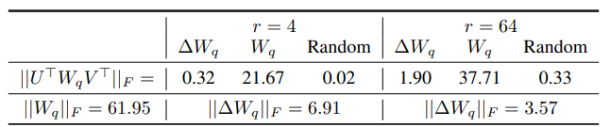
UNDERSTANDING THE LOW-RANK UPDATES
(iii) How much does W and ∆W correlate?
From the table, we can infer the following,
(a) Random << ∆Wq by correlation which shows that the ∆Wq amplifies some features in W
(b) Amplification factor: 21.5 ≈ 6.91/0.32 r = 4 has a huge amplification factor with r = 64 smaller
Thus we can conclude that W and ∆W correlate and amplifies the important features for the downstream tasks

Slide 21
CONCLUSIONS
LoRA is an memory and computation efficient strategy which achieves comparable or better performance than a fully finetuned model
Swappable modules, No additional inference latencies are some key features of LoRA

